Slide 1
Credit Risk Modeling

Slide 2
Executive Summary
Project Goal: To create a machine learning model that will predict a customer’s probability of default to accept or reject a customer for credit products.
Company Benefits:
Automation of Credit Decision Making
Increased Efficiency
Less Human Error
Allows employees to focus on more complex credit decisions
Recommendation: XGBoost Model - Aggressive Strategy
Probability of Default Acceptance Threshold: 0.5
Maintains Default Rate less than 10%
Maximizes Revenue: $1432

Slide 3
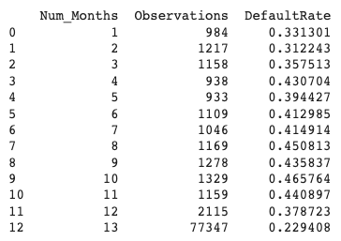
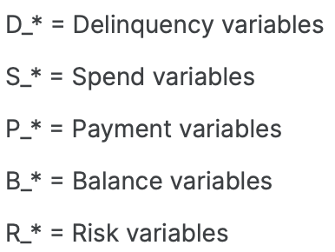
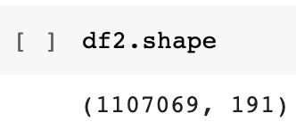
Data
Customer Credit Data based on the following features:
Includes up to 13 months of historical customer data.

Slide 4
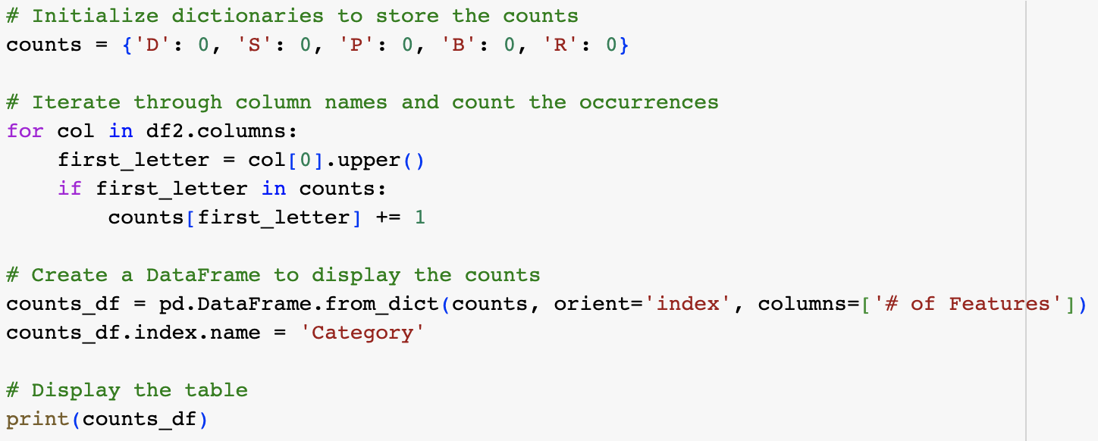
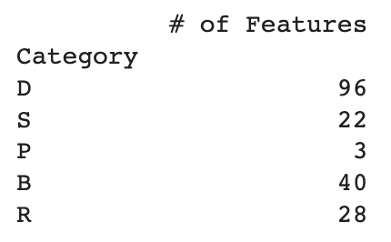
Features

Slide 5
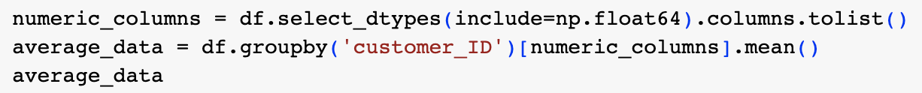
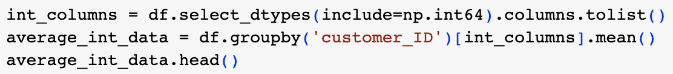
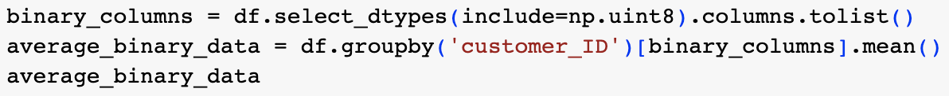
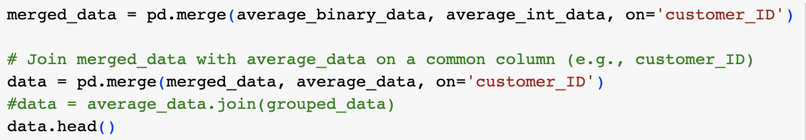
Feature Engineering
To aggregate customers with less than 13 months of historical data, numerical and categorical features were grouped by customer_ID and the mean value was calculated for each customer.
Code:

Slide 6
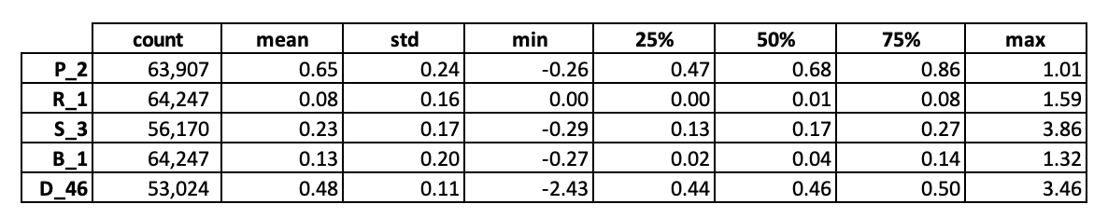
Feature Engineering (continued)
Summary Statistics for Top 5 Features with Highest SHAP values

Slide 7
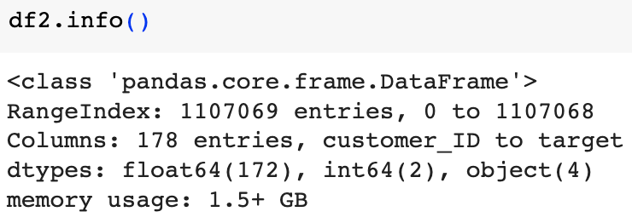
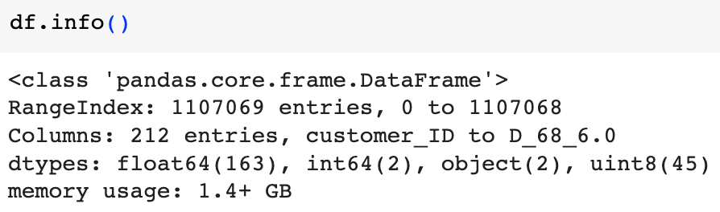
Data Processing – One Hot Encoding
Code to perform One-Hot Encoding:
Data before One-Hot Encoding:
Data after One-Hot Encoding:

Slide 8
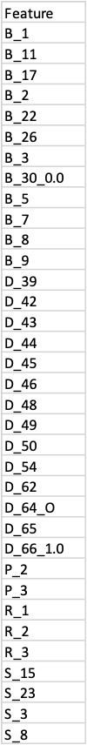
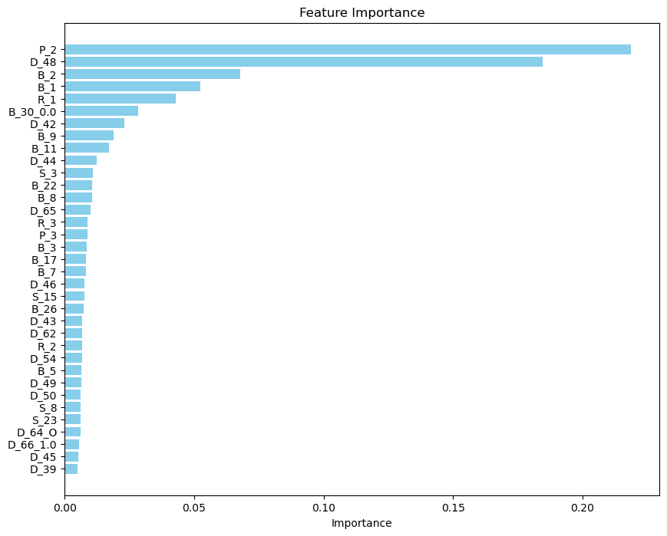
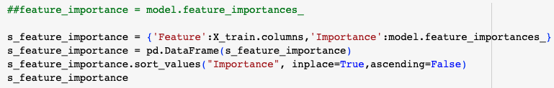
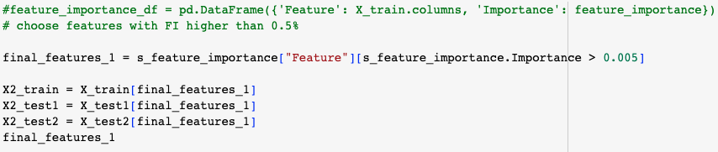
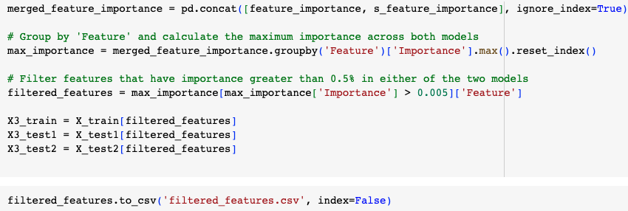
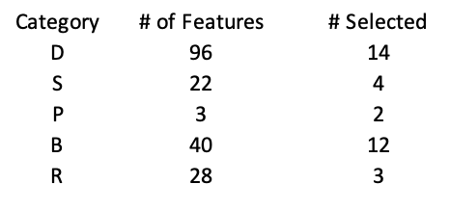
Feature Selection
Features with Feature Importance higher than 0.5% were used to build the XGBoost model.
A feature importance of 0.5% means that the corresponding feature contributes approximately 0.5% to the predictive power of the machine learning model.
Code
Results of Feature Importance
P_2 and D_48 have the highest predictive power on the XGBoost model.

Slide 9
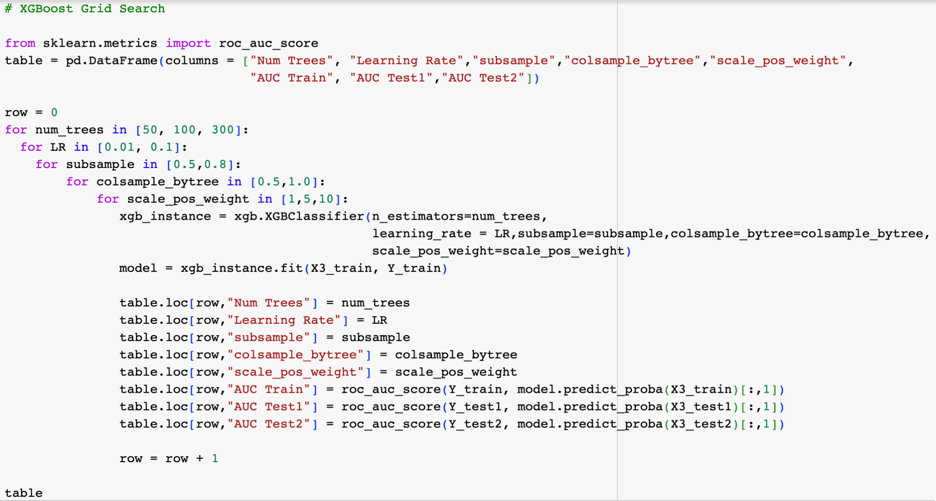
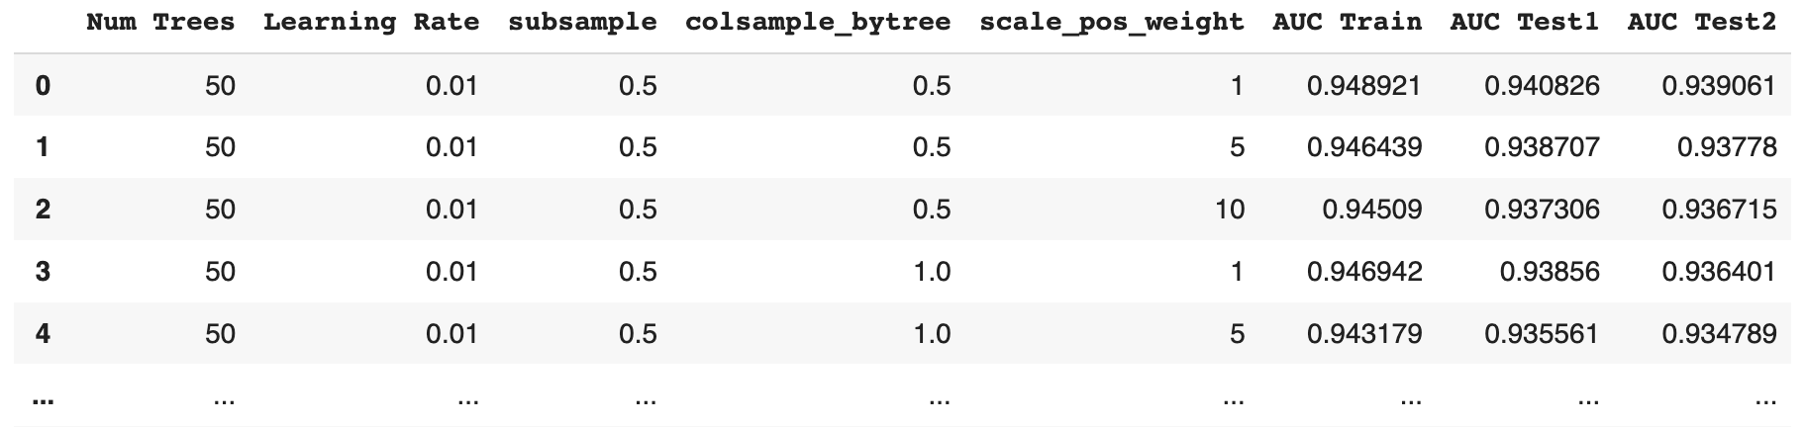
XGBoost - Grid Search
Number of models trained: 72
Number of Trees: 50, 100, 300
Grid searching over multiple values allows finding the optimal trade-off between performance (more trees) and efficiency (less trees).
Learning Rate: 0.01, 0.1
The learning rate determines how much each tree contributes to the overall prediction.
Percentage of Observations Used in Each Tree: 50%, 80%
Grid searching explores different subsample percentages to find the best value that balances overfitting and underfitting.
Percentage of Features in Each Tree: 50%, 100%
Limiting the number of features used in each tree can help reduce the risk of overfitting and speed up training.
Weight of Default Observations: 1, 5, 10
The dataset might be imbalanced with fewer default observations. Assigning higher weights to default observations can help the model better capture patterns.

Slide 10
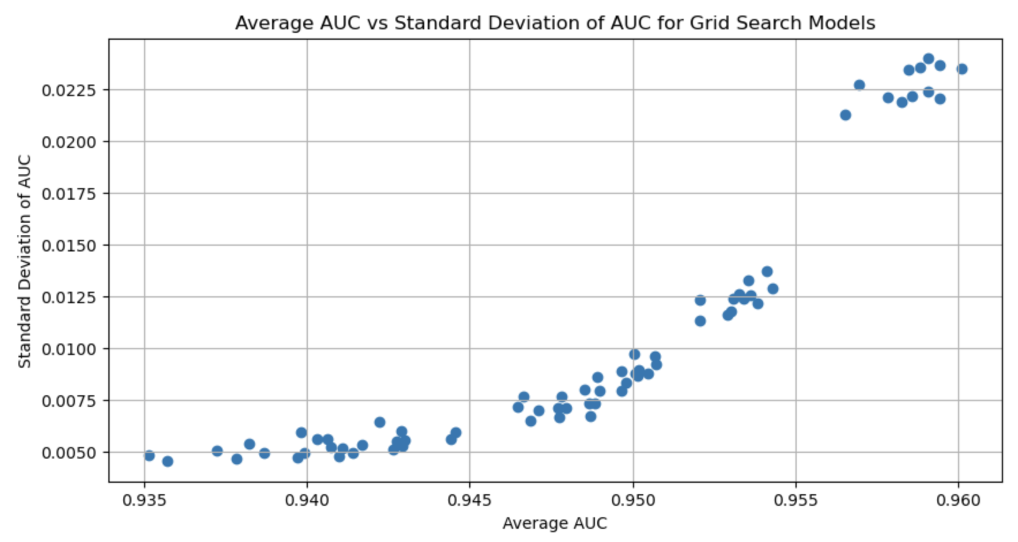
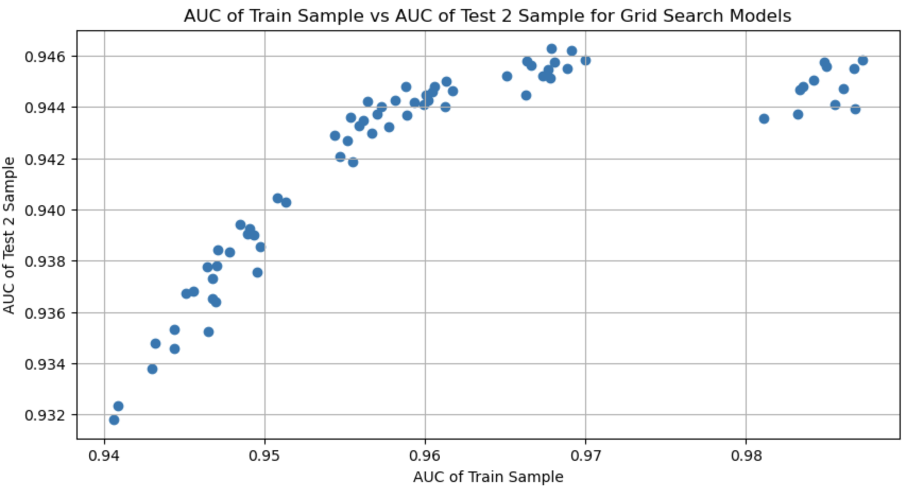
XGBoost - Grid Search
From the plot below between AUC of train and AUC test2 sample, the best model should have low bias and low variance i.e the AUC score of train and test should be higher and the difference of AUC between train and test should be low.
From the above plot, the best model should have Low standard deviation and high average AUC between the samples.

Slide 11
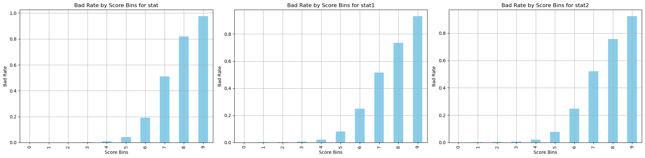
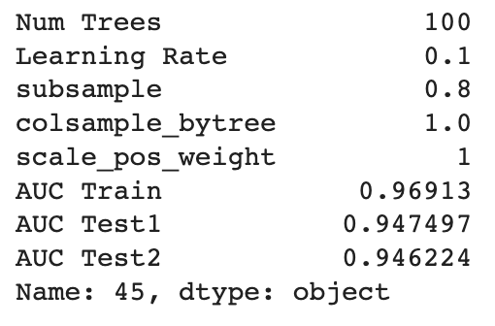
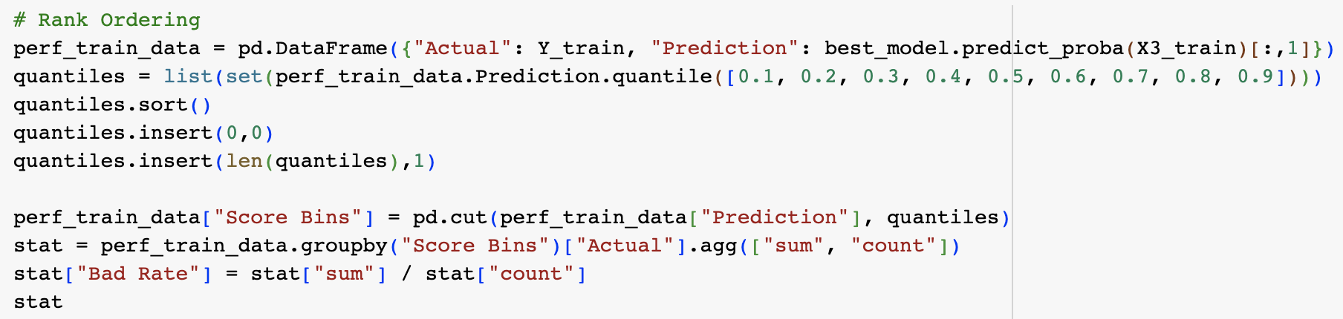
XGBoost – Final Model
Parameters of Final Model and AUC on each sample:
Code for Rank Ordering
Bad rate: Represents the proportion of individuals in each score bin who have defaulted on their loan.
From the Bad Rate table, as the range of score bins increase, so does the bad rate. This implies that the risk model is working correctly, as it suggests that a higher score is associated with a higher risk of default.

Slide 12
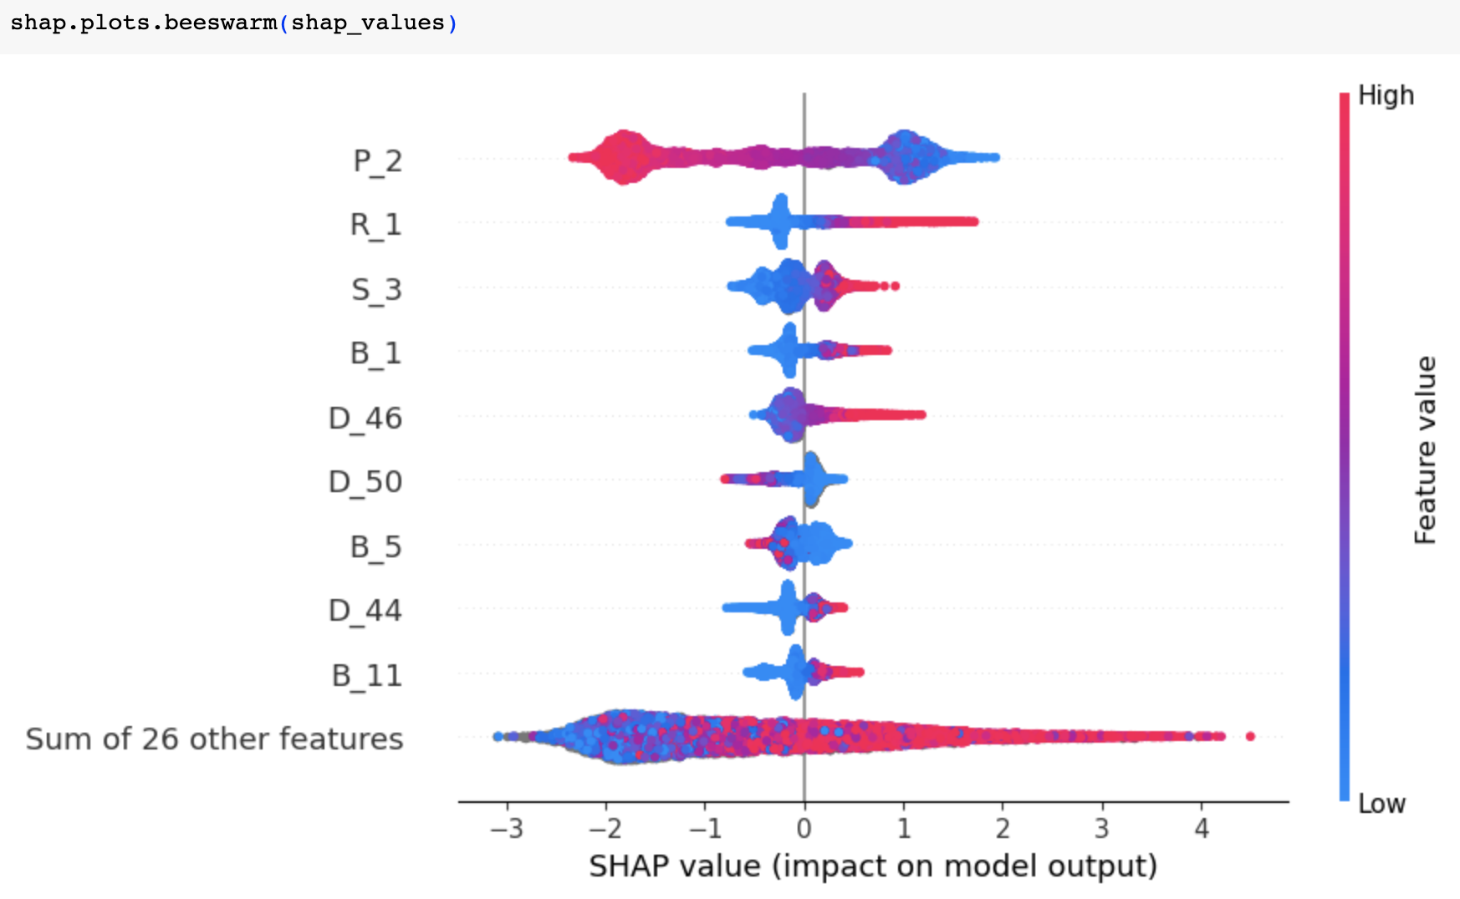
XGBoost – SHAP Analysis
Beeswarm Graph of Final Model
P_2, R_1, S_3, B_1, and D_46 have the highest impact on the model’s performance.
P_2 has the largest impact on the model.
For P_2, observations with lower SHAP values have higher impact on the model.

Slide 13
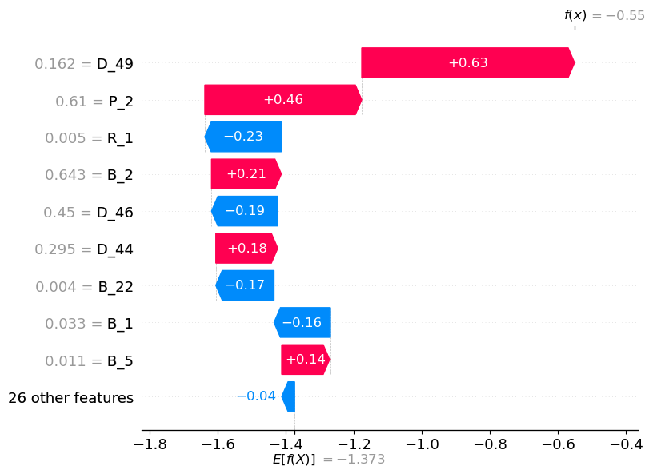
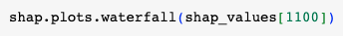
XGBoost – SHAP Analysis
Waterfall Graph of Final Model
For a particular observation (customer), D_49 has the largest impact on Probability of Default.
D_49 increases an observation’s SHAP value by 0.63
D_49, P_2, B_2, D_44, and B_5 increase the customer’s Probability of Default.
R_1, D_46, B_22, B_1 and 26 other features decrease the customer’s Probability of Default.
Code

Slide 14
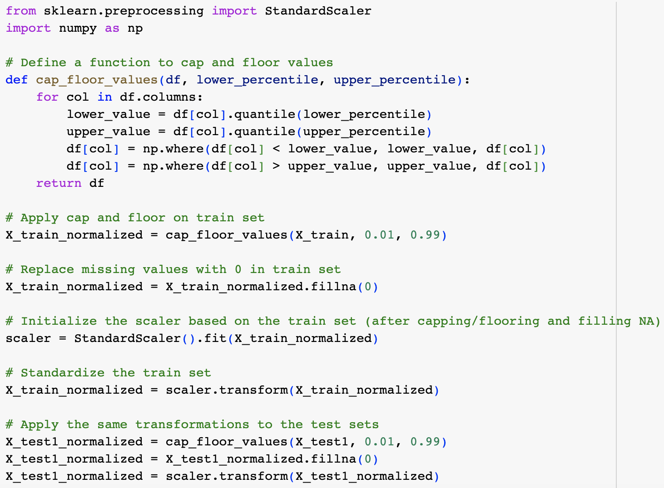
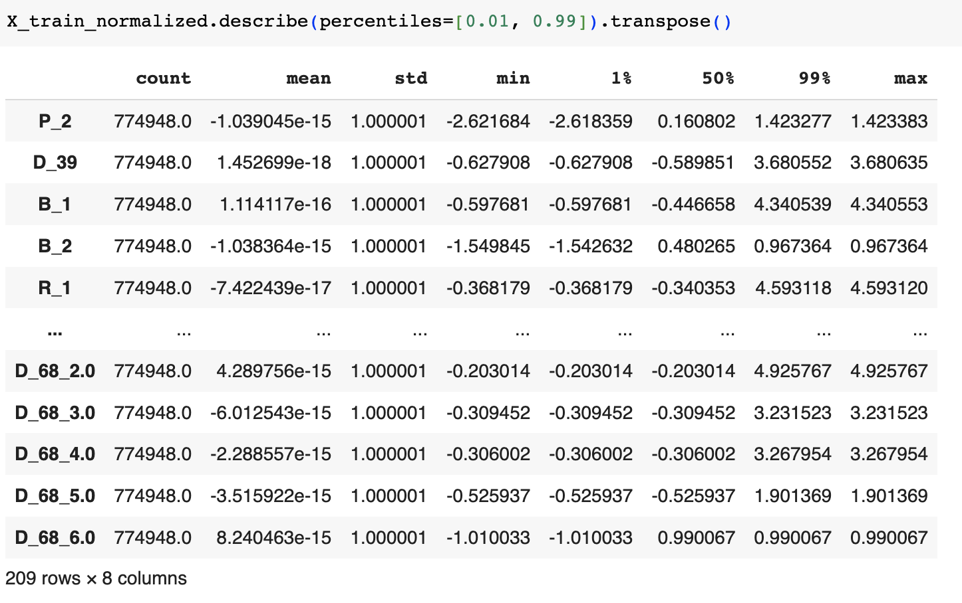
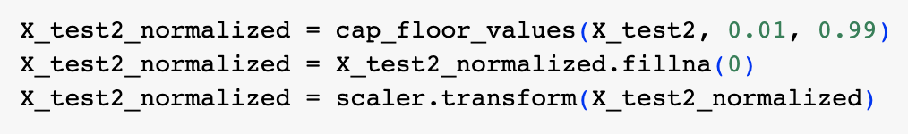
Neural Network – Data Processing
Normalization, Outlier Treatment & Missing Value Imputation
Results

Slide 15
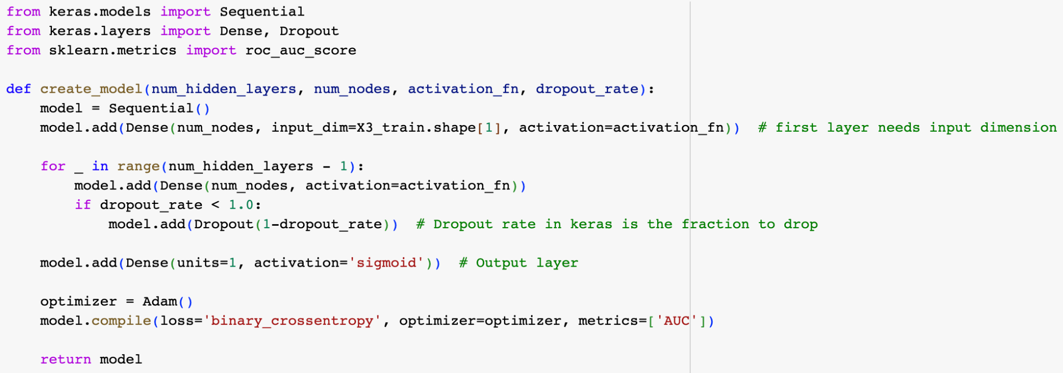
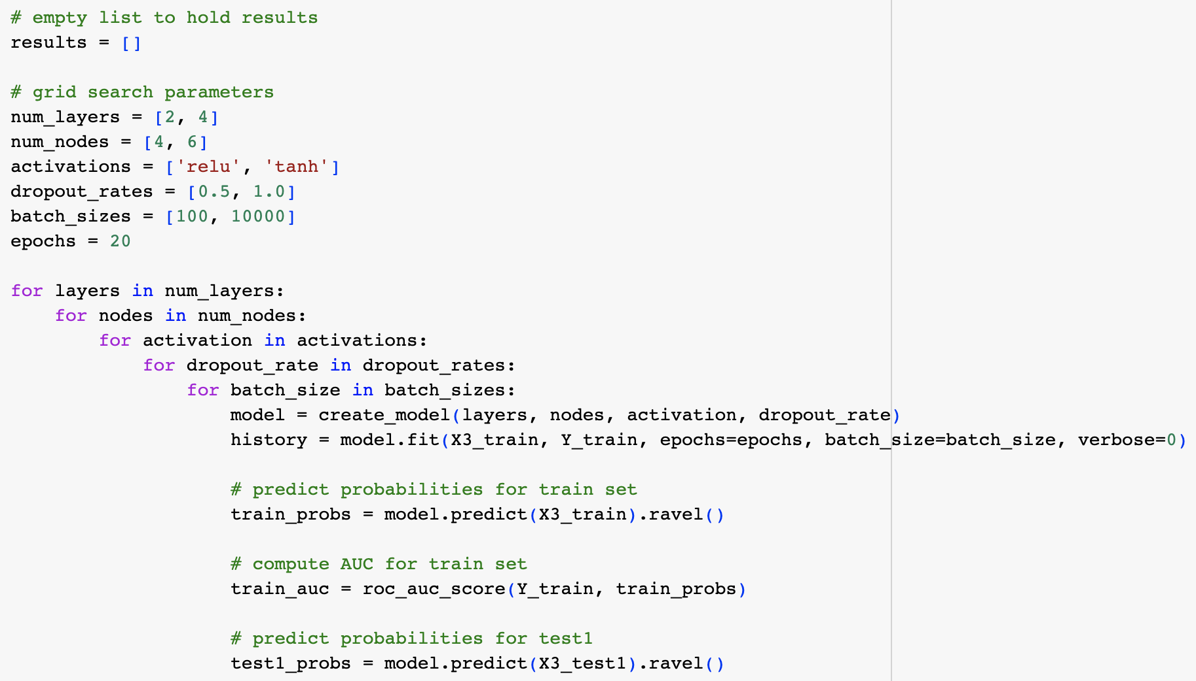
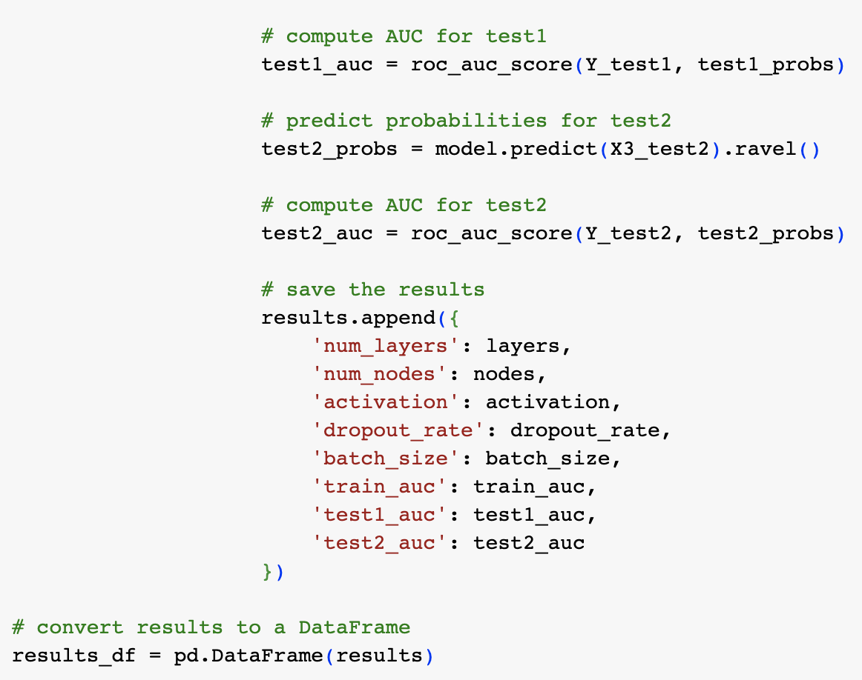
Neural Network - Grid Search
Number of models trained: 32
Parameter Explanations
Number of Hidden Layers: 2, 4
Including more layers allows the model to learn more complex representations of the data. Grid searching over different numbers of hidden layers helps determine the optimal depth of the neural network..
Number of Nodes in Each Hidden Layer: 4, 6
Grid searching over different numbers of nodes allows finding the right balance between model complexity and generalization.

Slide 16
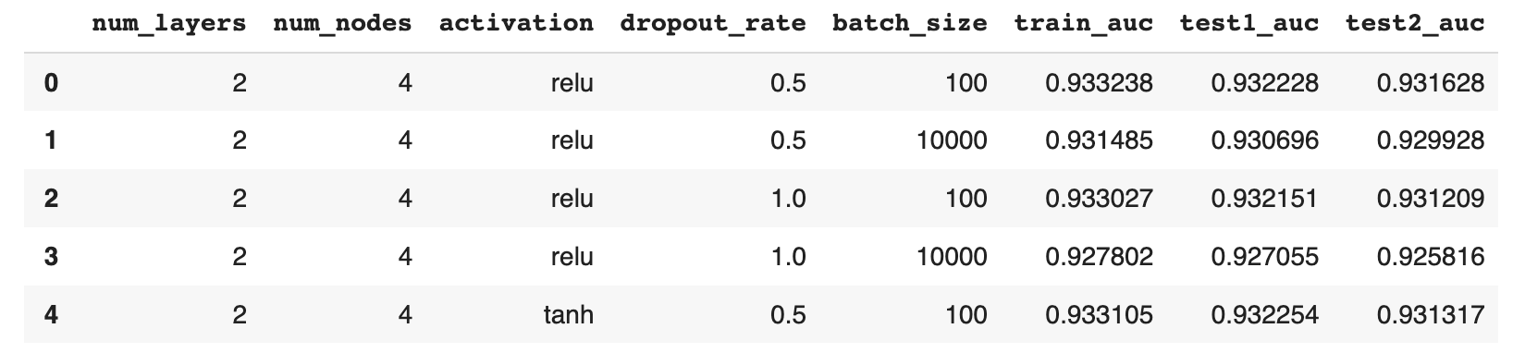
Neural Network - Grid Search (continued)
Parameter Explanations (Continued)
Activation Function for Hidden Layers: ReLU, Tanh
ReLU (Rectified Linear Unit) is a popular choice due to its simplicity.
Tanh is another common activation function that squashes values between -1 and 1, allowing the model to capture both positive and negative patterns.
Dropout Regularization for Hidden Layers: 50%, 100% (no dropout)
Dropout is a regularization technique that randomly sets a fraction of nodes to zero during each training iteration, effectively "dropping them out." This helps prevent overfitting.
Batch Size: 100, 10000
Batch size determines the number of samples processed together before updating the model's weights during each training iteration.

Slide 17
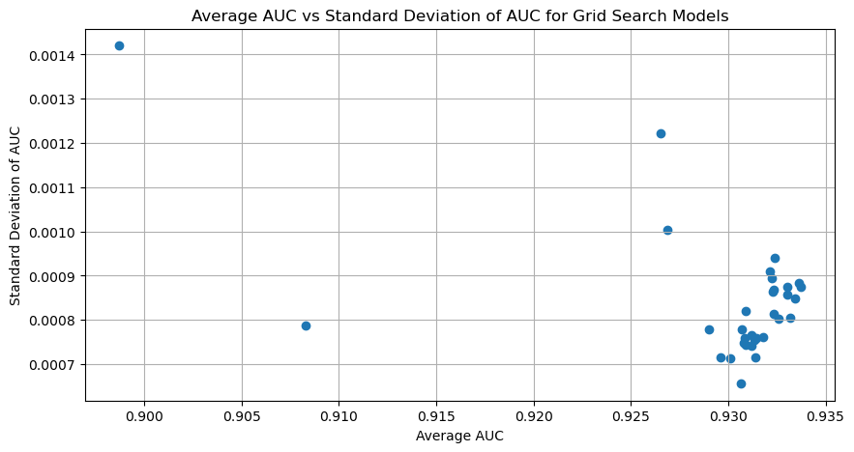
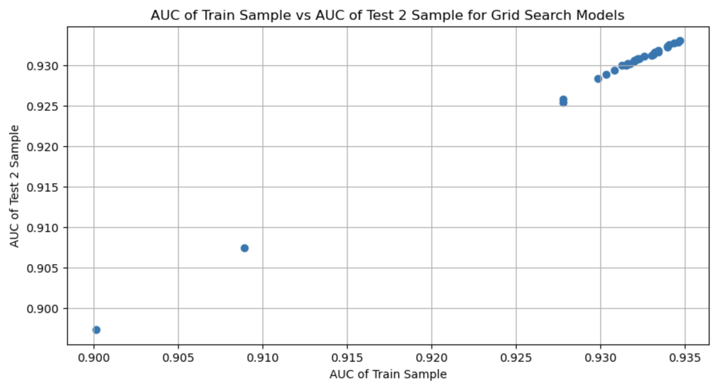
Neural Network - Grid Search
From the plot below between AUC of train and AUC test2 sample, the best model should have low bias and low variance i.e the AUC score of train and test should be higher and the difference of AUC between train and test should be low.
From the above plot, the best model should have Low standard deviation and high average AUC between the samples.

Slide 18
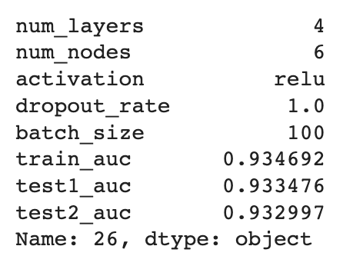
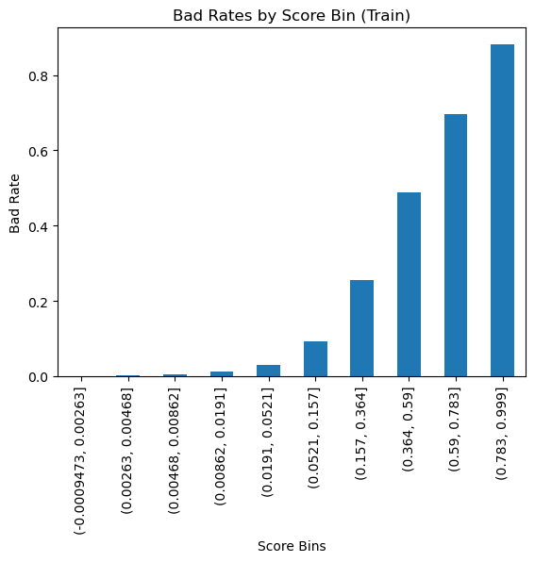


Neural Network – Final Model
Parameters of Final Model and AUC on each sample:
Sum: Represents the total number of defaults in the corresponding score bin range
Count: Represents the total number of customers in the corresponding score bin
Bad rate: Represents the proportion of individuals in each score bin who have defaulted on their loan.
From the Bad Rate table, as the range of score bins increase, so does the bad rate. This implies that the risk model is working correctly, as it suggests that a higher score is associated with a higher risk of default.

Slide 19
Final Model
Final Model Selection: XGBoost Model
Neural Network Model
Explanation of Decision:
Model 1 (Neural Network): Has AUCs of 0.934, 0.933, and 0.933 on the training, test1, and test2 sets, respectively. These numbers are fairly close, suggesting that the model is not overfitting and hence has low variance. The performance (as measured by AUC) is quite good, suggesting that the model also has low bias.
Model 2 (XGBoost): Has higher AUCs than model 1: 0.969, 0.947, and 0.946 on the training, test1, and test2 sets, respectively. There is a bigger gap between the training and test AUCs, suggesting the model may have a slightly higher variance than Model 1. However, the difference is not substantial, and the performance on the test sets is still very good. This model appears to have a low bias and a slightly higher variance compared to Model 1.
Both models seem to have a good balance of bias and variance, given their performances on the test sets are relatively close to their performances on the training sets. But if you want to prioritize a model that likely has a lower variance (and thus may generalize slightly better to new data), Model 1 might be a slightly better choice. Conversely, if you want to prioritize the model with the lowest bias (and thus the highest performance on the training set), Model 2 might be the better choice.
XGBoost Model

Slide 20
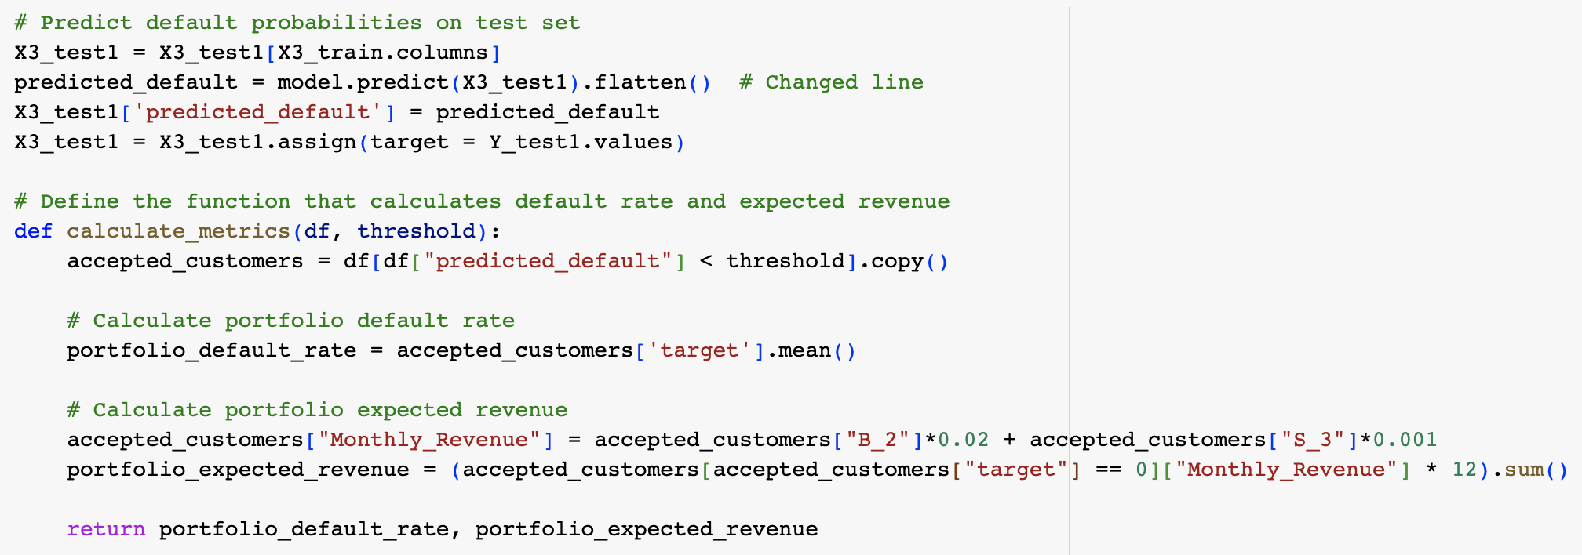
Strategy
Option #1: Conservative Strategy
Threshold: 0.3
Estimated Default Rate: 3%
Expected Revenue: $1335
As we increase the threshold, the model becomes more aggressive, accepting customers with higher probability of default.
Option #2: Aggressive Strategy
Threshold: 0.5
Estimated Default Rate: 8%
Expected Revenue: $1453.00
Recommendation: Aggressive Strategy
Maximize Revenue
Default Rate less than 10%
Revenue Function
 | Train |  | Test1 |  | Test2
Threshold | Defaut_Rate | Revenue | Default_Rate | Revenue | Default_Rate | Revenue
0.1 | 0.016 | 1261.97 | 0.015 | 1306 | 0.016 | 1262
0.2 | 0.031 | 1335.63 | 0.028 | 1382 | 0.031 | 1335
0.3 | 0.046 | 1380 | 0.044 | 1421 | 0.046 | 1390
0.4 | 0.063 | 1409 | 0.058 | 1445 | 0.063 | 1409
0.5 | 0.08 | 1432 | 0.075 | 1464 | 0.08 | 1425
0.6 | 0.1 | 1453 | 0.0981 | 1480 | 0.1 | 1453

